Slide 1
Analyzing the Impact of Car Features on Price and Profitability
DHARSHIKA.S

Slide 2
PURPOSE
This project aims to help car manufacturers optimize their pricing and product development strategies by understanding the key factors influencing car pricing and consumer demand. By leveraging a dataset with specifications on over 11,000 car models, we aim to identify trends and insights that will support data-driven pricing strategies, consumer demand analysis, and feature development.

Slide 3
APPROACH
I had performed a comprehensive analysis using Excel, employing various functions to clean and manipulate the dataset. This involves:
Data Cleaning: Handling missing values, removing duplicates or blanks , and feature engineering.
Data Analysis: Analyzing to identify patterns and correlations.
Visualization: Creating visual representations of the data to better communicate findings.
Regression Analysis: Applied regression models to predict MSRP based on relevant features, helping quantify the importance of variables like fuel type, transmission type, and market category.
Correlation and Market Segmentation: Employed correlation analysis to understand relationships between continuous variables and used market segmentation to distinguish consumer preferences across categories.

Slide 4
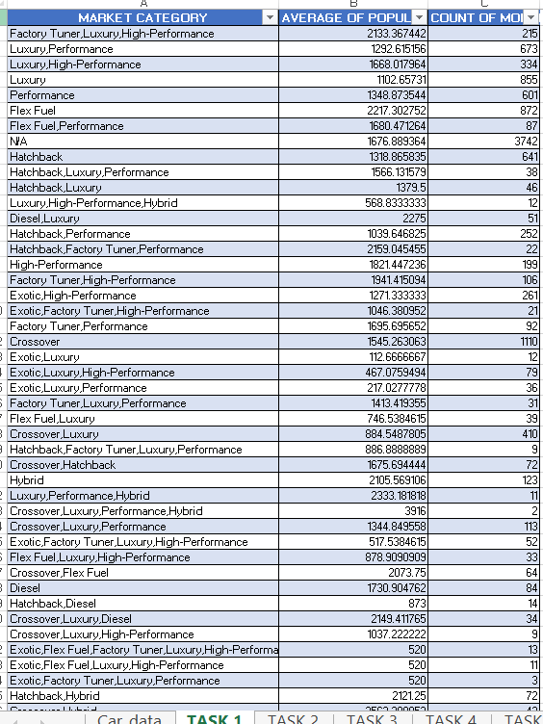
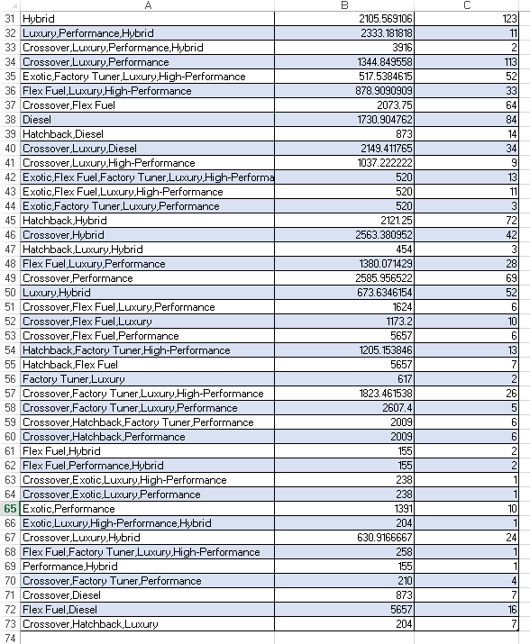
1. How does the popularity of a car model vary across different market categories?
Task 1.A: Create a pivot table that shows the number of car models in each market category and their corresponding popularity scores.
Task 1.B: Create a combo chart that visualizes the relationship between market category and popularity.

Slide 6
2. What is the relationship between a car's engine power and its price?
Task 2: Create a scatter chart that plots engine power on the x-axis and price on the y-axis. Add a trendline to the chart to visualize the relationship between these variables.

Slide 7
3. Which car features are most important in determining a car's price?
Task 3: Use regression analysis to identify the variables that have the strongest relationship with a car's price. Then create a bar chart that shows the coefficient values for each variable to visualize their relative importance.

Slide 8
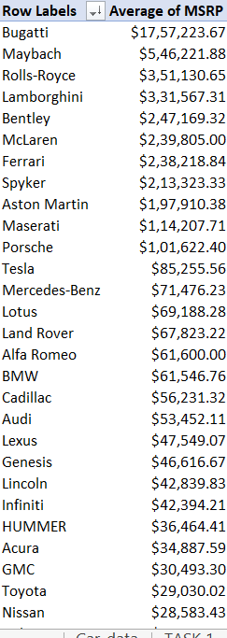
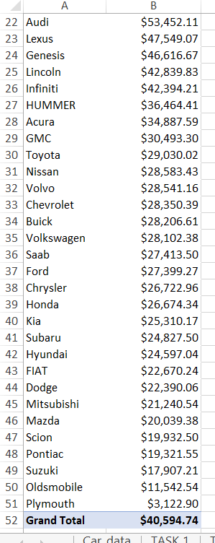
4.How does the average price of a car vary across different manufacturers?
Task 4.A: Create a pivot table that shows the average price of cars for each manufacturer.
Task 4.B: Create a bar chart or a horizontal stacked bar chart that visualizes the relationship between manufacturer and average price.

Slide 10
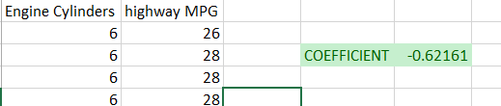
5.What is the relationship between fuel efficiency and the number of cylinders in a car's engine?
Task 5.A: Create a scatter plot with the number of cylinders on the x-axis and highway MPG on the y-axis. Then create a trendline on the scatter plot to visually estimate the slope of the relationship and assess its significance.
Task 5.B: Calculate the correlation coefficient between the number of cylinders and highway MPG to quantify the strength and direction of the relationship.

Slide 12
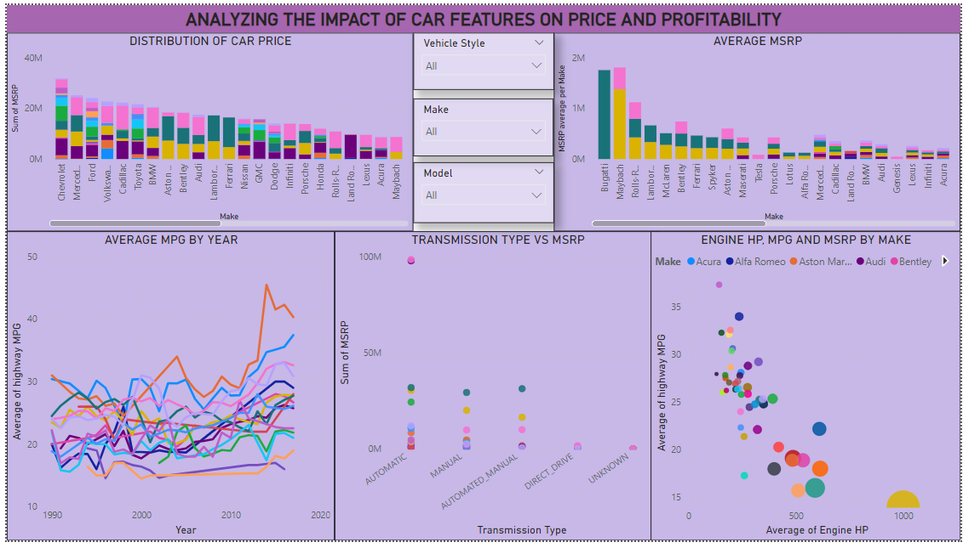
DASHBOARD

Slide 13
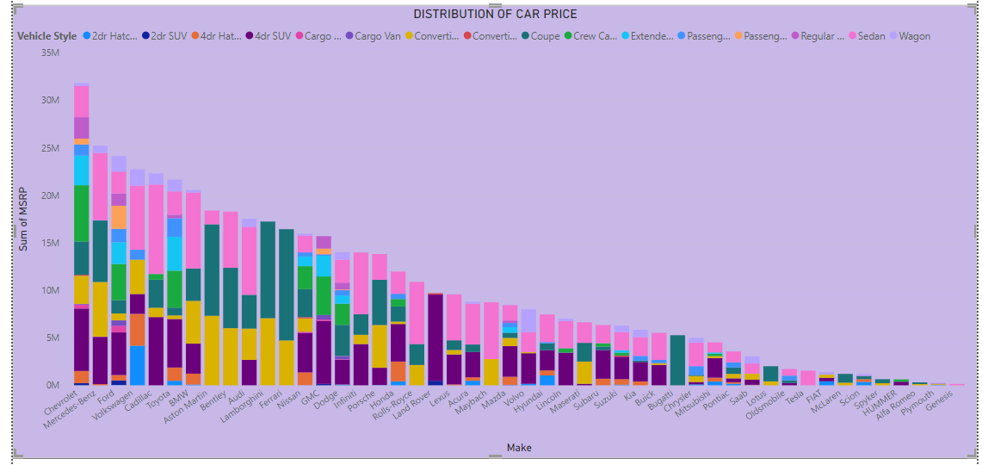
1. How does the distribution of car prices vary by brand and body style?

Slide 14
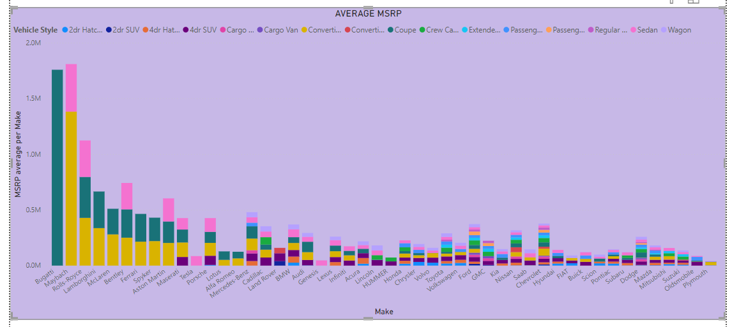
2. Which car brands have the highest and lowest average MSRPs, and how does this vary by body style?
Bugatti Coupe model has highest average MSRP
The least MSRP is mostly the passenger Minivan model of brands.

Slide 15
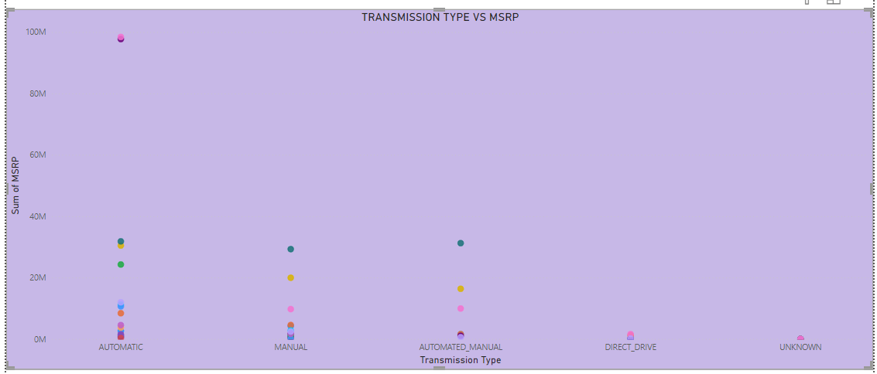
3. How do the different feature such as transmission type affect the MSRP, and how does this vary by body style?

Slide 16
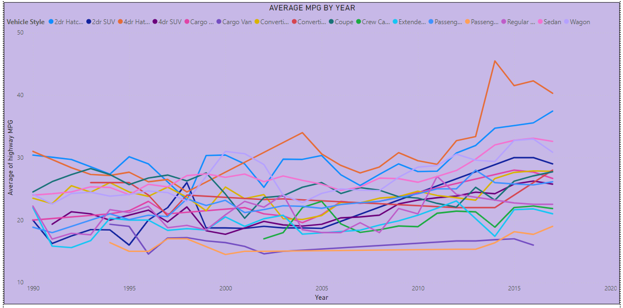
4. How does the fuel efficiency of cars vary across different body styles and model years?

Slide 17
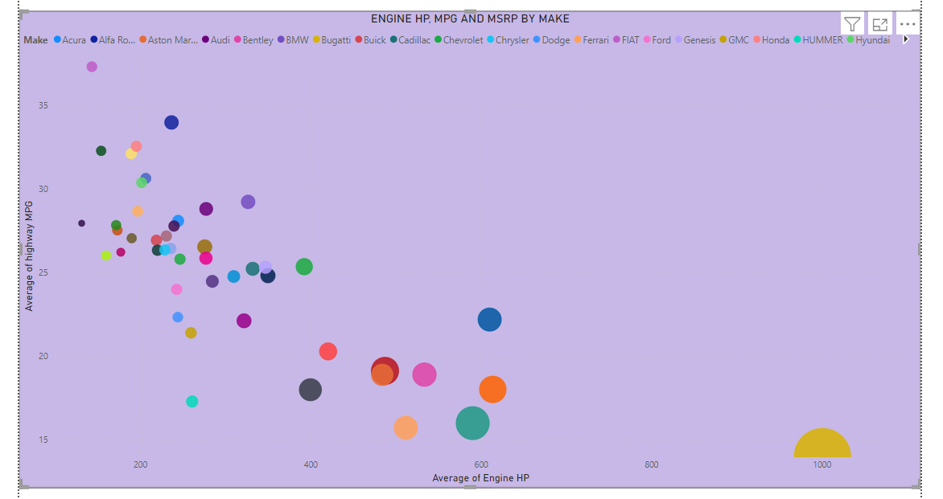
5. How does the car's horsepower, MPG, and price vary across different Brands?

Slide 18
Tech-Stack Used
Microsoft Excel 2022: Used for data analysis, data cleaning, imputation, creating pivot tables, and calculating statistical functions such as CORREL, COUNTIF, and AVERAGE.
Google Drive: Used for sharing the final report and the Excel sheet.
Power BI : To build interactive dashboards.

Slide 19
Conclusion
Market Category Popularity: Certain market categories, like luxury and sports cars, rank higher in popularity, indicating strong consumer interest in high-end, feature-rich vehicles.
Engine Power and Price: A strong positive correlation exists between engine power and MSRP, particularly within luxury and sports categories, where higher engine power often drives up perceived value and cost.
Transmission Type Influence: Cars with automatic transmissions tend to have higher MSRPs than their manual counterparts, suggesting that consumers value convenience and manufacturers should focus more on automatic models.
Fuel Efficiency Preferences: Cars with higher MPG ratings are generally more popular, especially in economy and compact body styles, underscoring consumer demand for fuel-efficient options.

